Slide 1
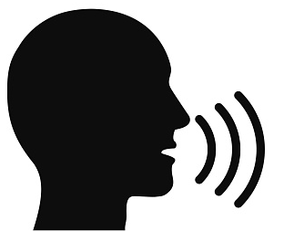
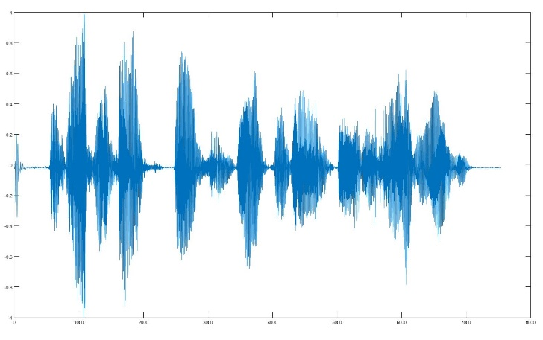
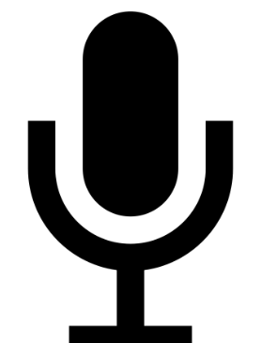
Introduction to audio signal processing in MATLAB

Slide 2
Table of content
Audio signals
Introduction
Multi-channel
Audio and Video
The human voice
First digital applications
The human voice nowadays
Applications
Classical
Advanced
Deep learning approaches

Slide 3
Audio signals
Audio is a particular class of 1D signals which represent sounds.
Usually, they are acquired by means of microphones that convert the air pressure wave into electronic (voltage) signal.
The recorded electronic signal is sampled and quantized to obtain a digital representation of the sound.
A similar procedure is conducted to capture seismic signals and underwater sounds, using different sensors (geophone and hydrophones, respectively).

Slide 4
Sampling frequency and bit depth
Frequency
the human audible spectrum ranges from 20 Hz to 20 KHz.
Intensity
we cannot perceive very subtle intensity changes in the sound;
indeed, a log scale is used to measure sound intensity (decibel).
To avoid distortions, a simple analog to digital conversion requires:
low-pass filtering to avoid aliasing
sampling (e.g. 48000 samples per second)
quantization (e.g. 24 bits per sample)

Slide 5

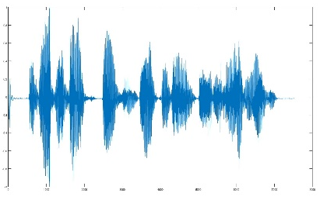

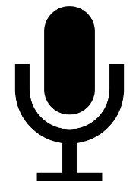
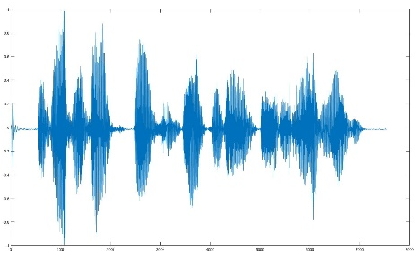
Multi-channel audio signals
The same audio sources can be acquired by different microphones for different reasons:
Diversity
To retrieve the sound direction
To make the environmental acoustics more realistic using multiple speakers
Different acquisitions experiment different attenuation and delay.
They are normalized and synchronized during post-processing operations.

Slide 6
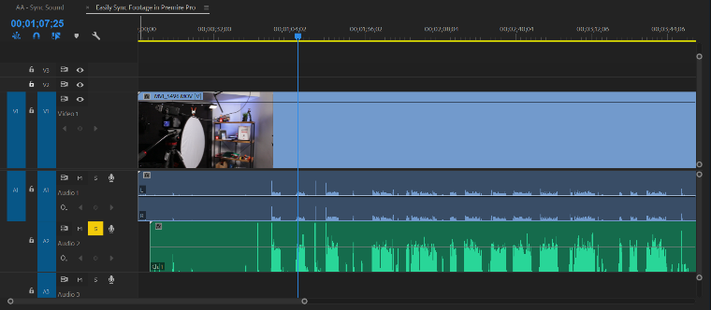
Audio tracks and video clips
Standard video containers include both
the video clip (sequence of still frames);
the audio track (single or multi-channel audios).
Video and audio are sampled at a very different sampling rate, e.g.:
Video: from 25/30 up to 60 frames per second
Audio: 48000 samples per second
Audio/video source synchronization is very important in this application.

Slide 7
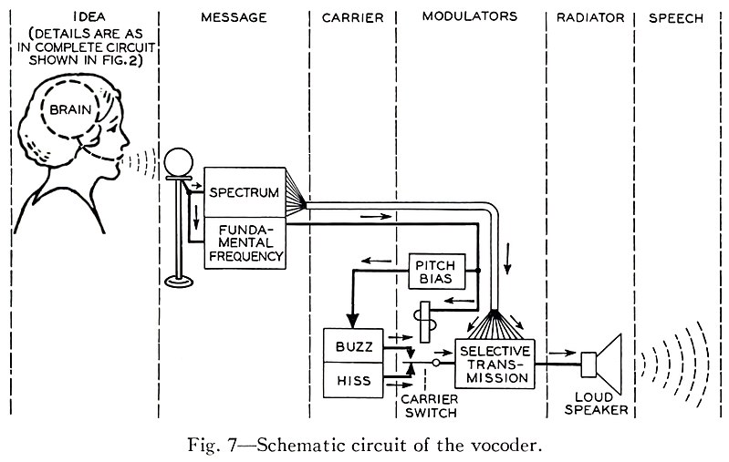
The special case of voice signals
Human voice analysis has very long history.
In 1938, the first vocoder (voice coder) was presented.
This was able to codec and synthetize the human voice.
This concept was lately exploited by the Global System for Mobile (GSM) Communication standard (2G cellular network) to preserve bandwidth.

Slide 8
The special case of voice signals (continue)
Nowadays, the human voice is the interface for many smart/IoT applications
Deep learning make it possible for the user to use its voice to get access to:
Buildings
Systems
Information

Slide 9
Applications
Classical applications:
Enhancement, like denoising
Effects, like echo
Source separation
Voice synthesis, like text2speech
Notes:
Underlined are the applications you will see in the exercises.

Slide 10
Applications
Advanced applications:
Active noise control
Speaker recognition or speaker feature classification (e.g. gender classification)
Speech to text and command recognition, implemented by most virtual assistant software
Realistic audio synthesis
Notes:
Underlined are the applications you will see in the exercises. Moreover audio command recognition exercise is illustrated in module 3.

Slide 11
Two classes of deep-learning approaches
Deep learning-based approaches can be grouped in two classes:
From RAW signals: the audio signal is fed to the deep neural network as
Preprocessing for better training stability: amplitude normalization or resampling
1D convolutional neural networks or long-short term networks are employed
From audio features: handcrafted audio features, like a specific spectrogram*, or learned (e.g. extracted by a pre-trained LSTM) are fed to a new network
Exploits domain knowledge by extracting task-specific features
Improves performance by training a deep neural network
2D convolutional neural networks are employed, too
* A 2D representation of the audio signal in the time-frequency domain, for more information see this practical introduction

